Slide 1

Occlusion detection in video surveillance systems
Context Aware Security Analytics in Computer Vision
Professors: Michele Nappi, Ignazio Passero
Project coordinator: Carmen Bisogni
Michelangelo Esposito - 0522500982

Slide 2
Occlusion in CV – Key concepts
Subjects in a scene may be partially or completely hidden behing other objects
Occlusion categories
Occlusion attributes
Dynamic occlusion
Scene occlusion
Apparent occlusion
Extent
Duration
Complexity

Slide 3

Dealing with occlusion
Kalman Filter Assisted Occlusion Handling
Local search
Detecting occluded regions

Slide 4
Goal of the project
Build a Machine Learning framework capable of detecting occlusion.
Input: a video of variable length and a number n
Output: the n best (least occluded) frames of the video

Slide 5
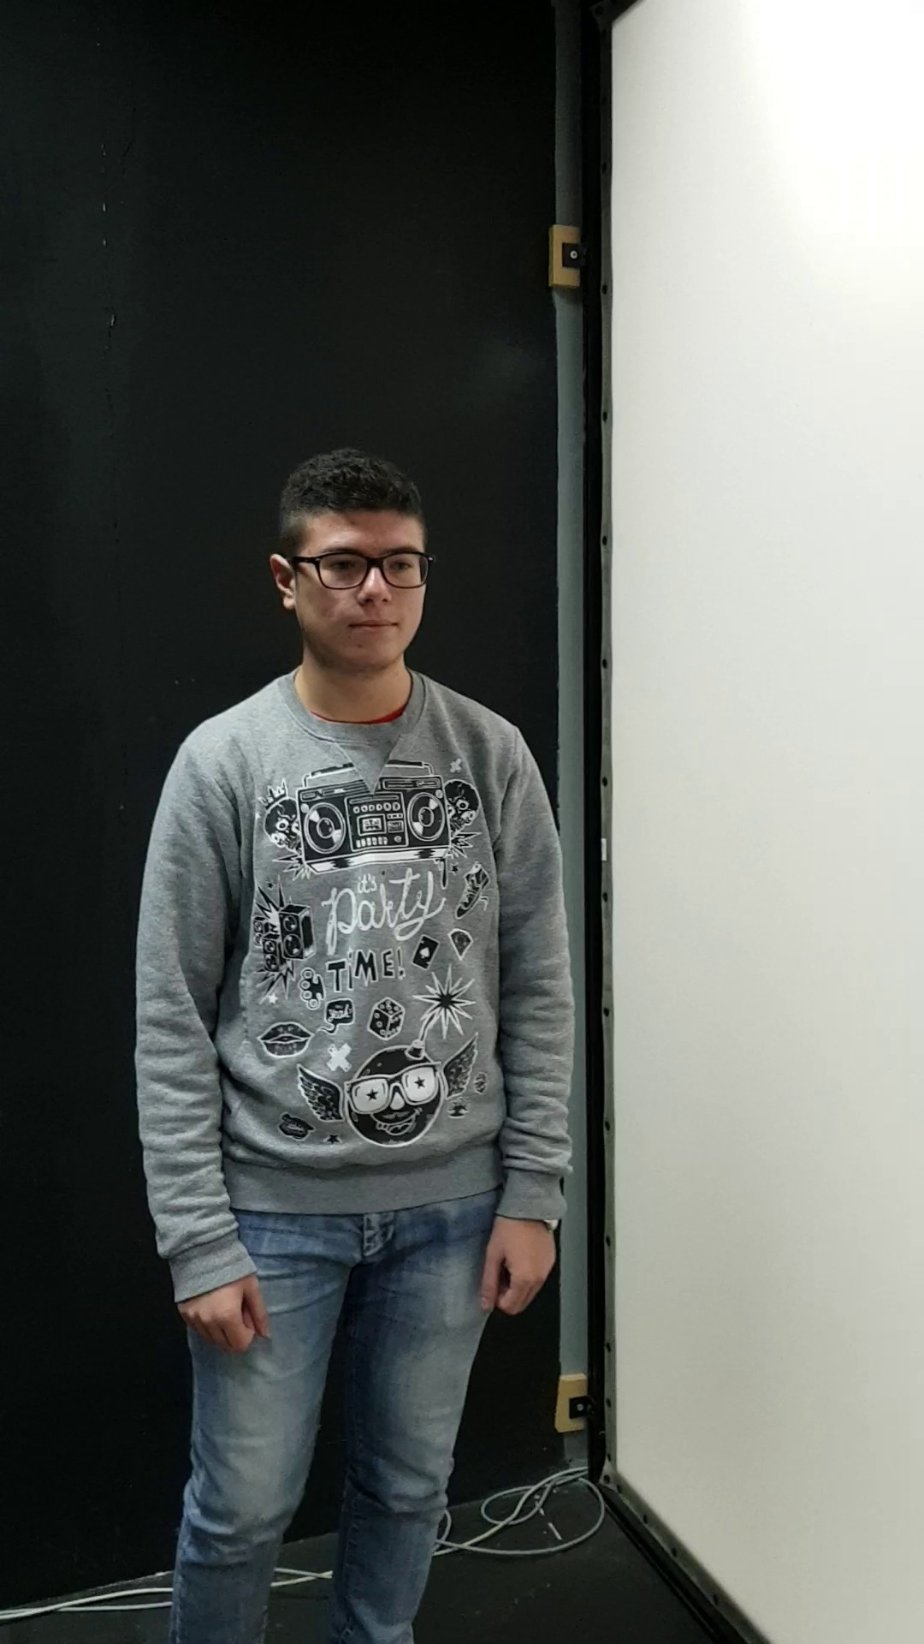
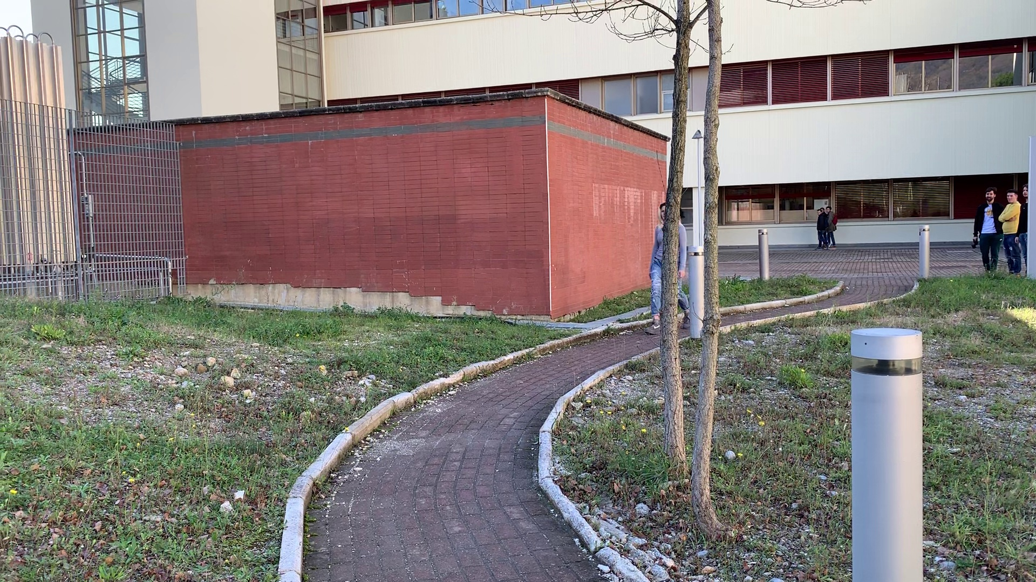
GOTCHA-I dataset
493 videos
Diffeent subjects, environments and lighting conditions
10 videos selected per environment

Slide 6
Data processing - Steps
Frame extraction
Key-points extraction and processing
Labelling
Resizing
Data splitting

Slide 7
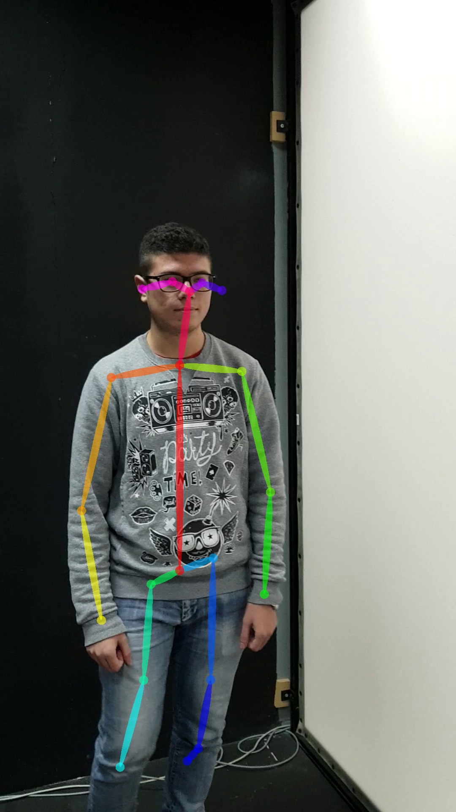
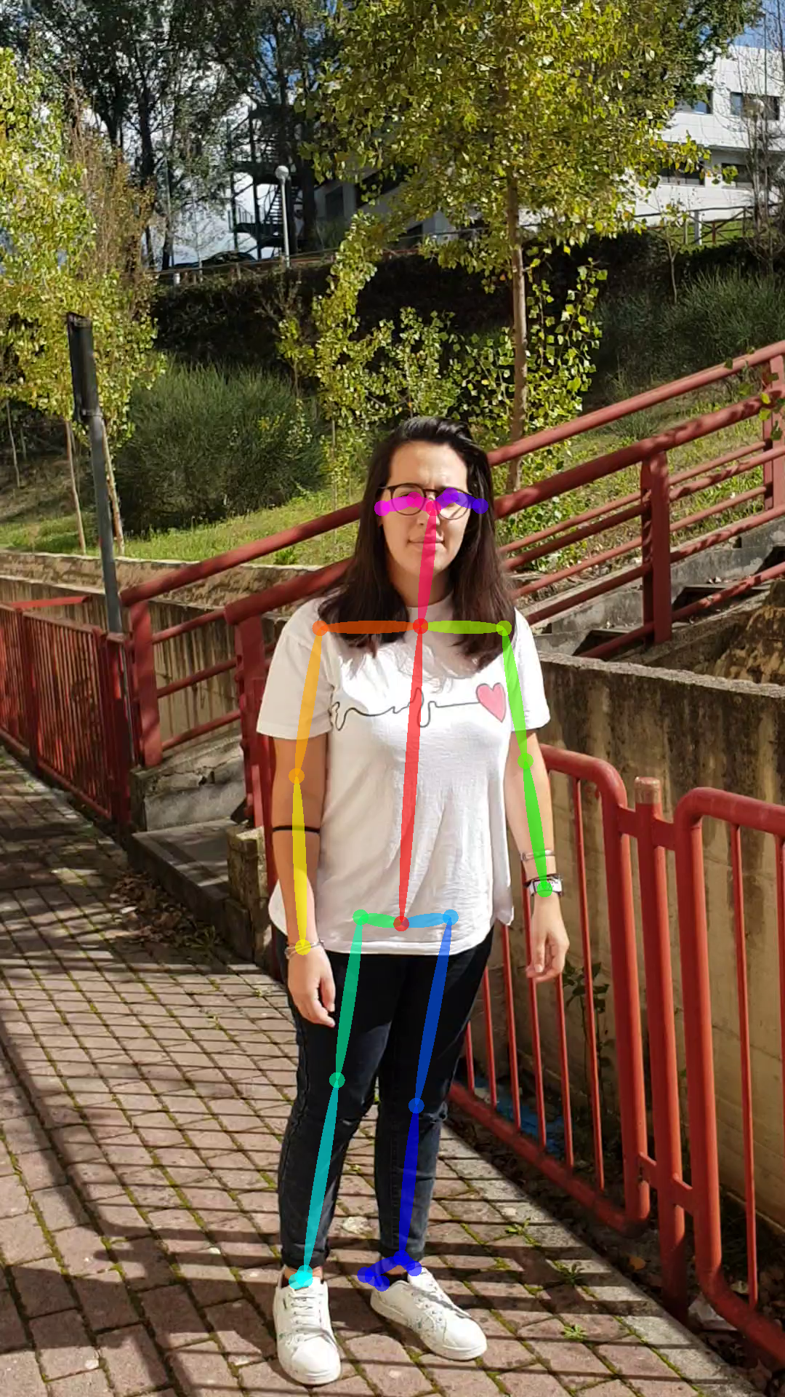
Data processing - OpenPose
Open source Machine Learning for keypoint detection and tracking
Prediction of occluded areas
25 key-points per subject
Wide variety of output formats (JPG,
JSON, XML, YML, …)

Slide 8
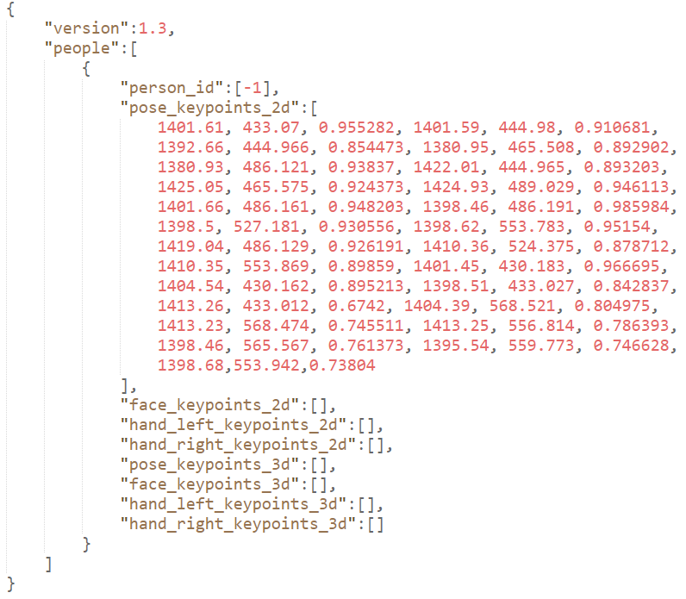
Data processing - OpenPose
Key-points extracted in JSON format
Over 38.000 processed frames
Fast execution on GPU using NVIDIA’s
CUDA

Slide 9
Data processing – Labelling and partitioning
Automatic classification of "Good"(1) and "Bad"(0) frames based on detected keypoints
Partition in three csv files:
Train: 80%
Validation: 10%
Test: 10%

Slide 10

Network architecture
Two convolutional layers
Two max pooling layers
One hidden layer
Output layer

Slide 11
Network architecture
ReLU activation function
Sigmoid for the output layer
Adam optimizer
Binary cross entropy loss function
20 epochs with a batch size of 128

Slide 12
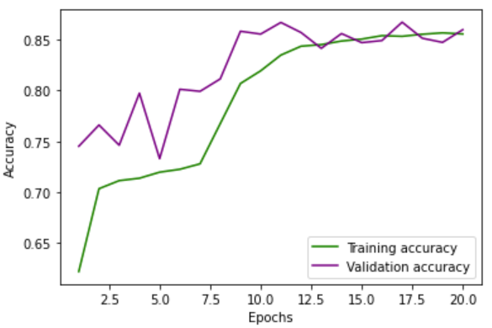
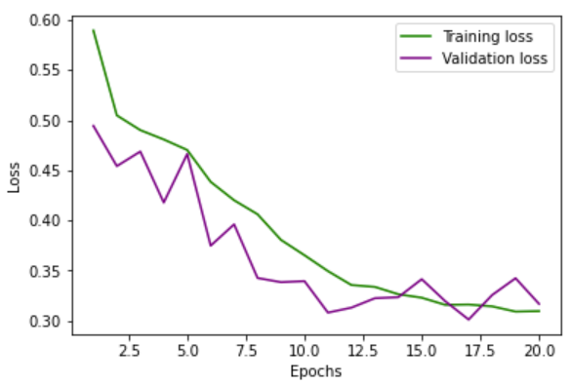
Performance evaluation
Training process overview:

Slide 13
Performance evaluation
Test accuracy of 0.81
Lower accuracy in dark environments/bad lighting condition
Very good performance in open spaces and from far away
Good performance in most other cases

Slide 14
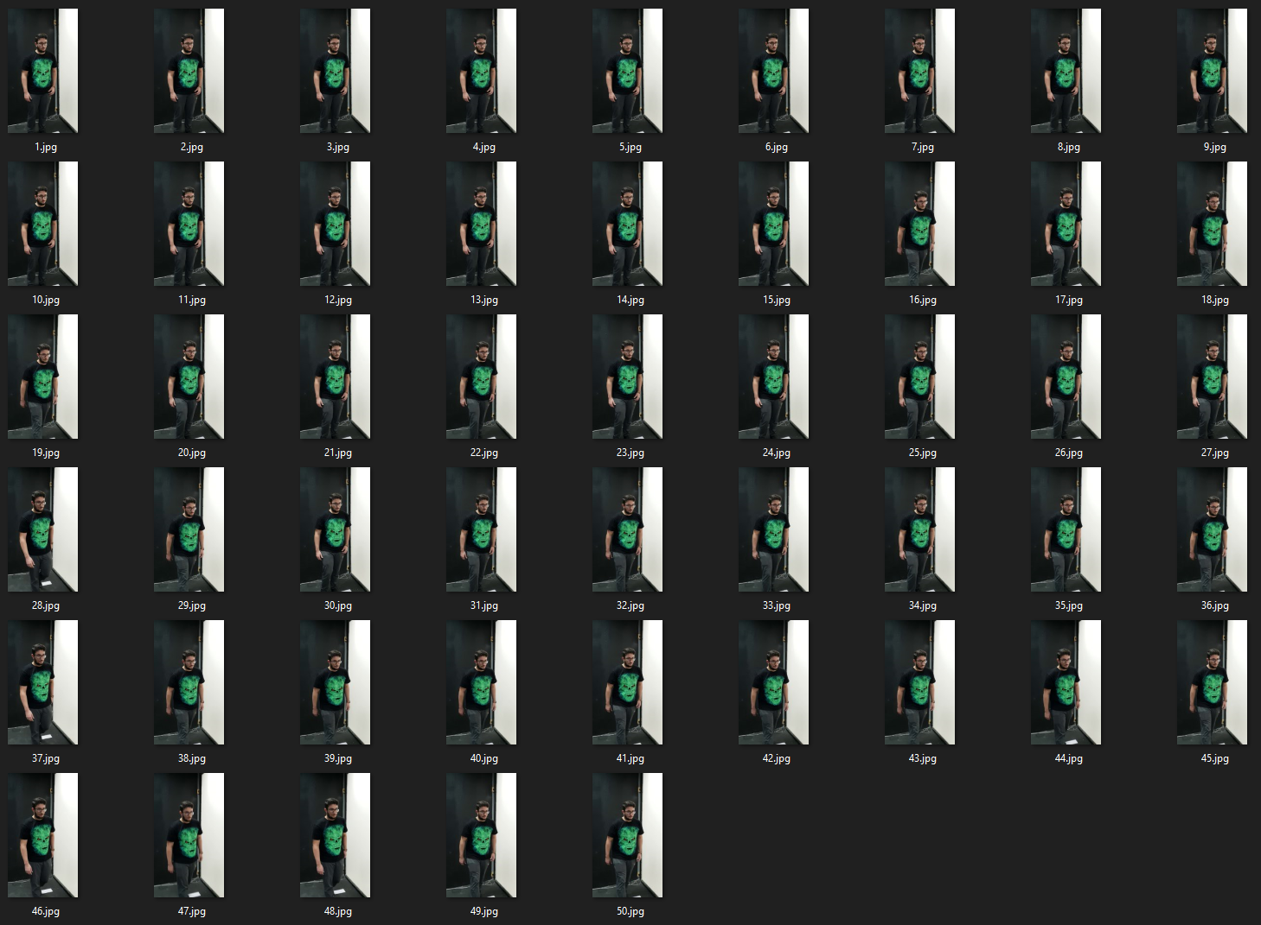
Performance evaluation
Example: the 50 best frames
of a never seen before video

Slide 15
Thank you for the attention

